Slide 1

Facebook Metric Analysis
AKHIL TEJA KANUGOLU (16297766)
SRI SAI NIKHIL KANTIPUDI (16292907)

Slide 2
Description of Problem:
This study presents a research approach using Machine learning for predicting the performance metrics of posts published in brands Facebook pages.
Facebook Metrics is the data related to posts published during the year 2014 on the Facebook’s page of a renowned cosmetics brand.
This dataset is taken from https://archive.ics.uci.edu/ml/datasets/Facebook+metrics.

Slide 3
Description of Dataset:
Facebook Metrics data set contains 500 Records and 19 features. The aim is to use 19 features to predict target using independent features
Dimension: 500 Records, 19 Features, memory usage: 74.3+ KB
Features:
Page total likes: how many likes the page had when post went live
Type: what kind of post (video, link, status, photo)
Category:3 levels- Action,
Post Month
Post Weekday
Post Hour
Paid
like
share
comment
total interactions
Post metrics (recorded after posting, EDA only)

Slide 4
Flow Chart:
Loading And Viewing Data
Loading Facebook Metrics Data Set
Viewing the Data set With considering Various Features
Exploratory Data Analysis
Understanding relationships and new insights through plots
Handling outliers
Modeling
Splitting into Train & Test
Linear, Lasso, Random Forest, SVR
Data- Preprocessing
Validating the Model
Handling the Missing Data
Checking the Correlation (Feature Selection)
Scaling the Data

Slide 5
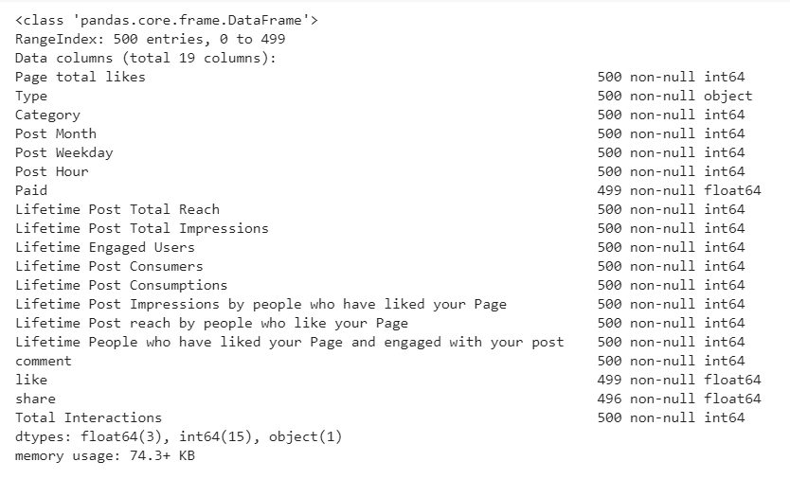
Loading And Viewing Data
Loading the Facebook Metrics Data set & checking the features , Data types of respective features( Independent & Dependent )

Slide 6
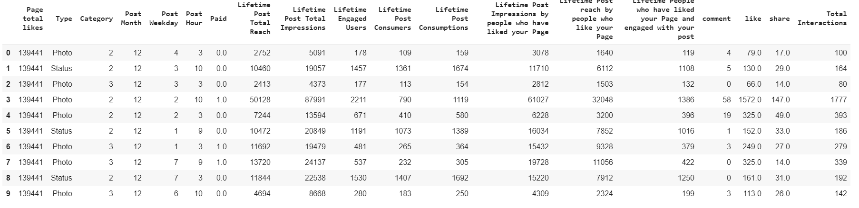
Checking the head of first 10 Rows of the Dataset helps to understand the Variables.

Slide 7
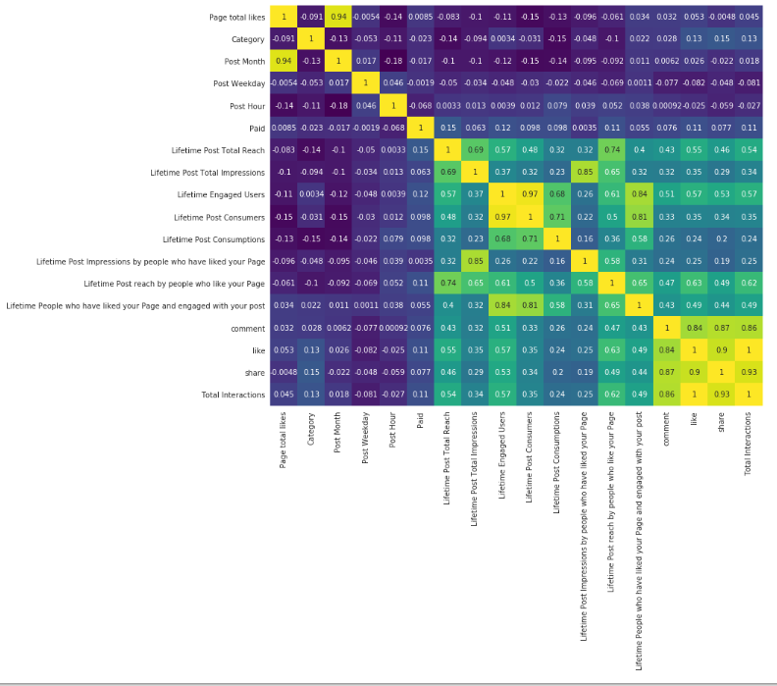
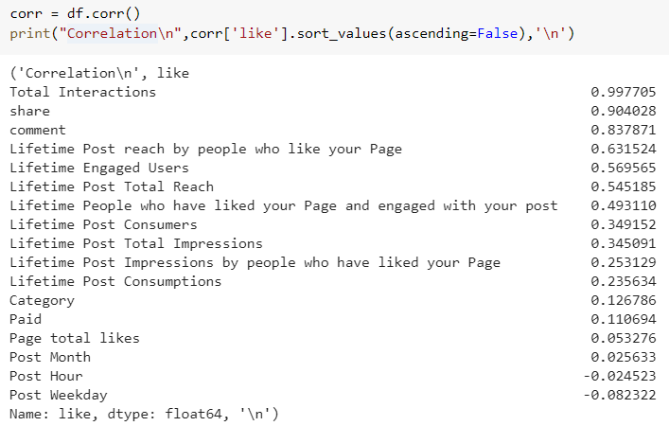
EDA:
Correlation between Features respective to Like was observed & correlation between every feature.
Checking the head of first 10 Rows of the Dataset helps to understand the Variables.

Slide 8
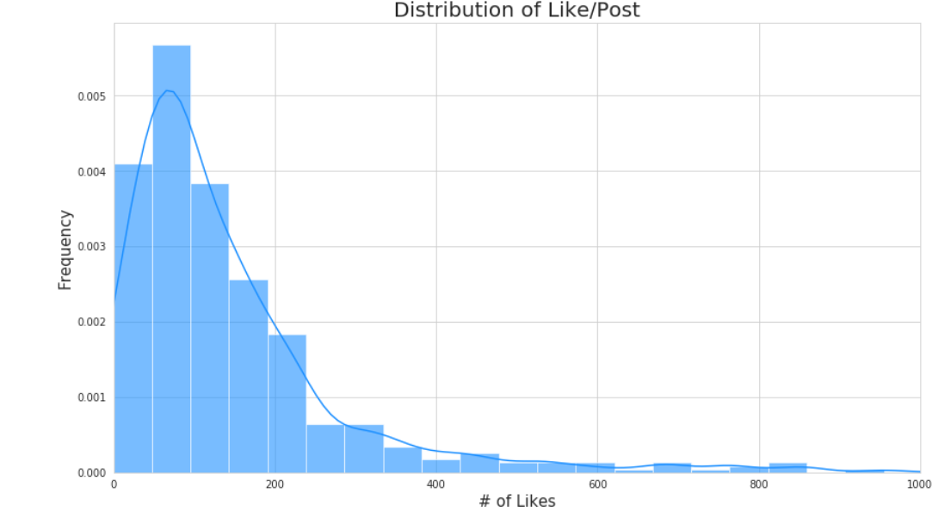
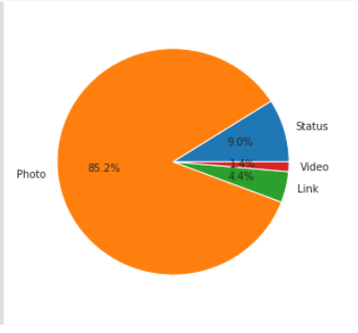
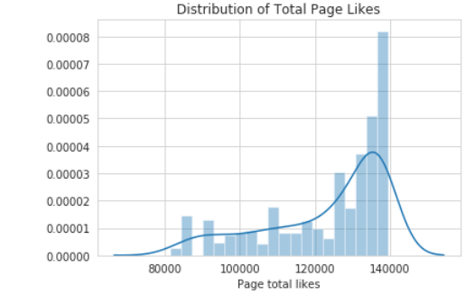
Page Likes and Post Likes
From the observation Post likes are peak during the initial time of post & loss the pace later.
While page likes are vice versa.
And Most of the likes are through photo type

Slide 9
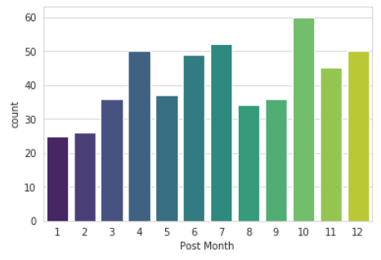
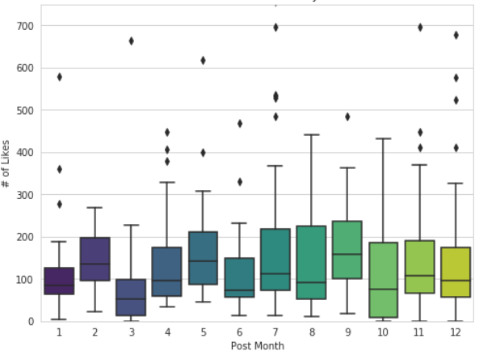
Analysis of Likes based on Month
Most of the Like’s came in October month & Median likes at September.

Slide 10
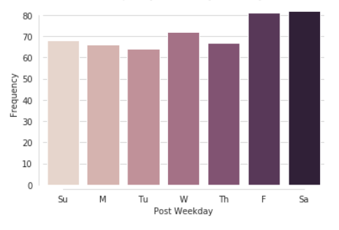
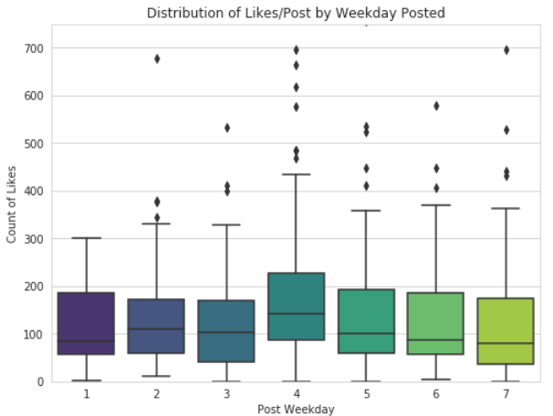
Weekday:
We can observe Most of the likes got on Friday & Saturday
And From range we can say that Wednesday posts likes range was more compared to other.

Slide 11
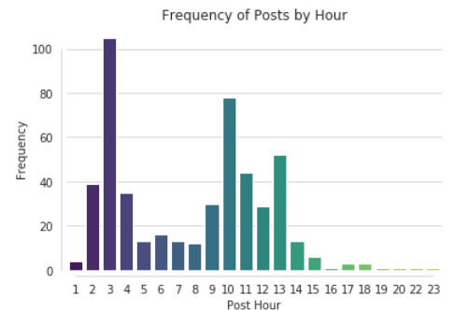
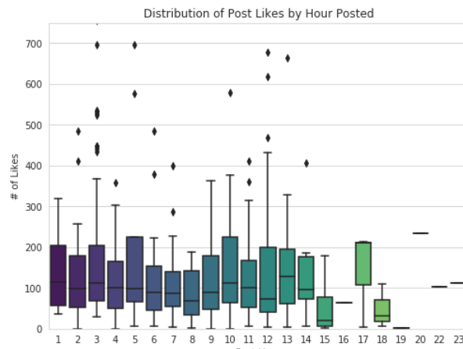
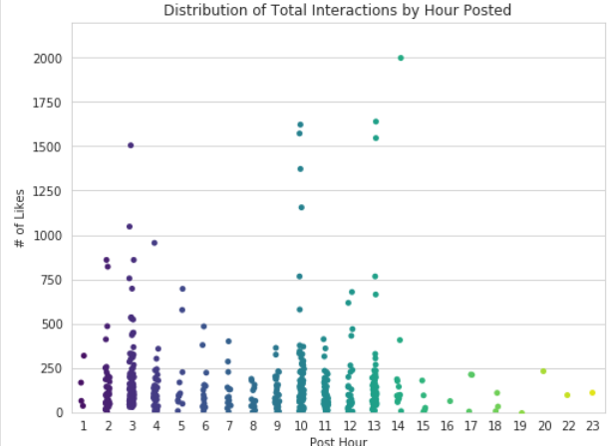
According to Hours:
Post reach was more at 3 Am. Later, at 10 Am & 1 pm
Median of Likes are similar at 4 AM to 7 Am

Slide 12
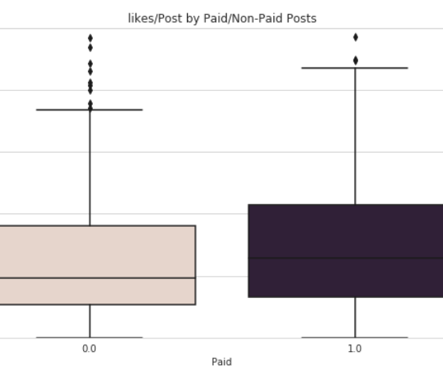
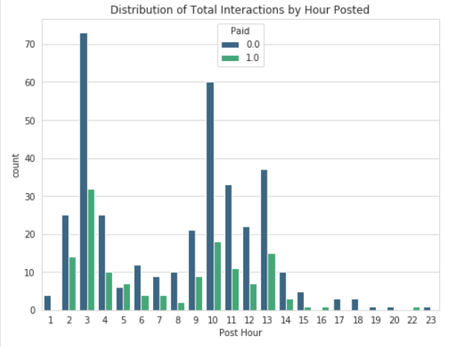
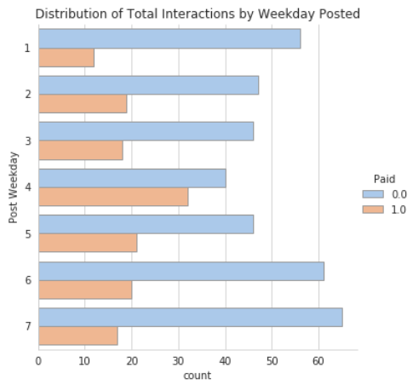
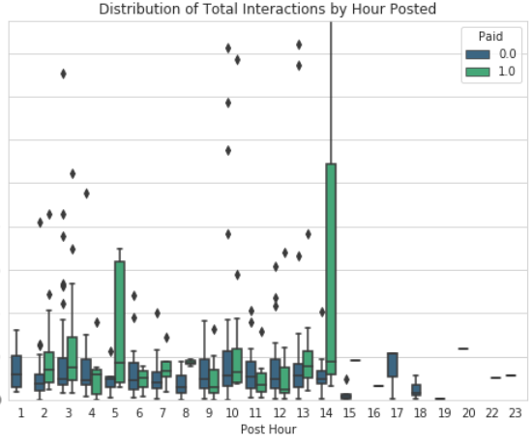
Analysis According to Paid/Not Paid:
On average video posts had higher engagement
Photo posts had the largest range
This suggests that total interactions can depend on the photo posted
Links performed the worst, with the lowest mean, range, and median
Status on average performed 2nd best in terms on mean engagement, with the second largest range.
No difference in paid link posts
Paid Status Posts had higher likes on average when compared to non-paid status posts

Slide 13
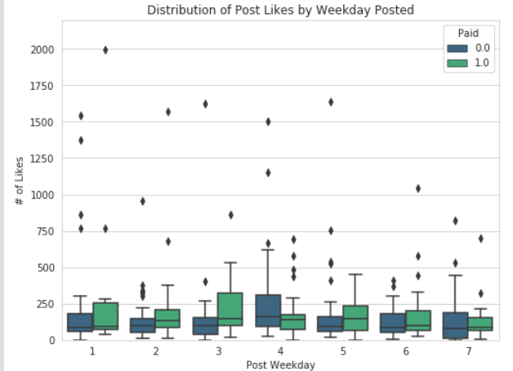
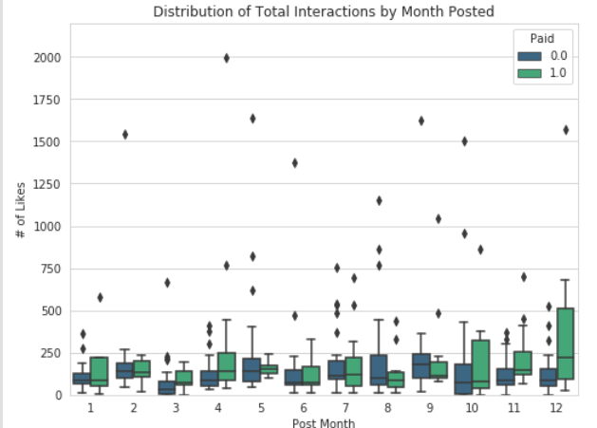
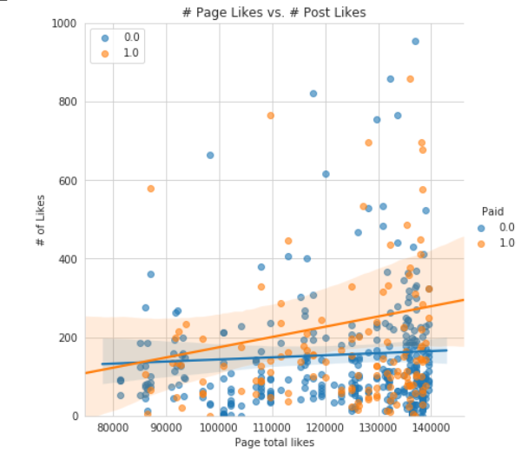

Slide 14
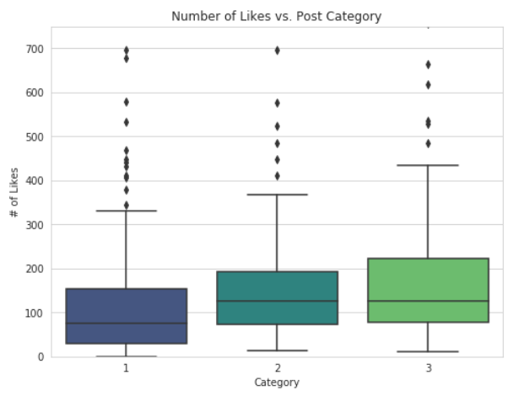
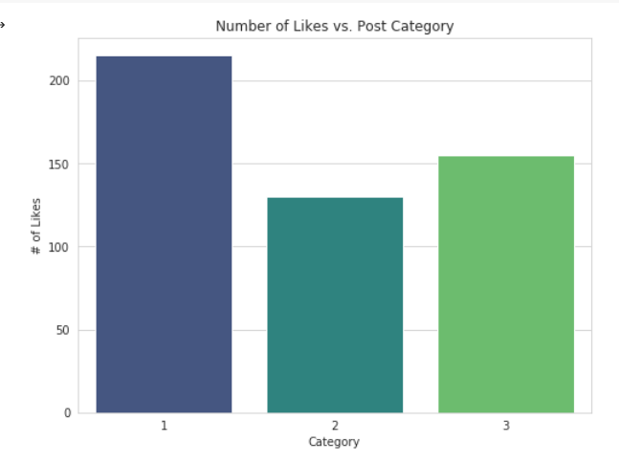
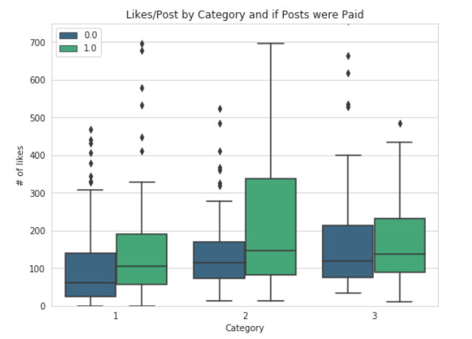
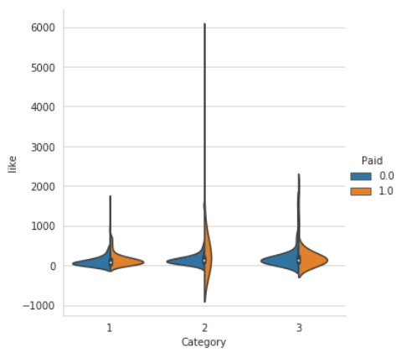
Category vs Likes
The most posts were of category 1 posts
Paid Category 2 posts saw the largest increase, followed by 1 and then 3.
Categories 1 and 2 performed similarly, while Category 3 performed better for Non-Paid

Slide 15
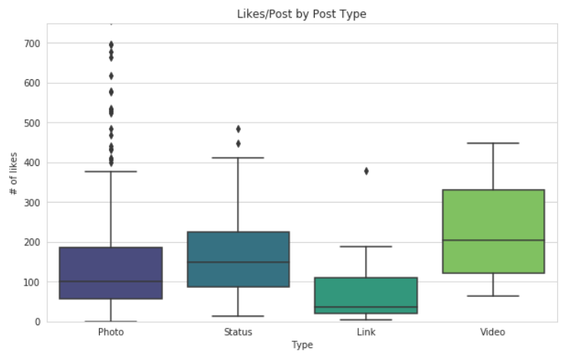
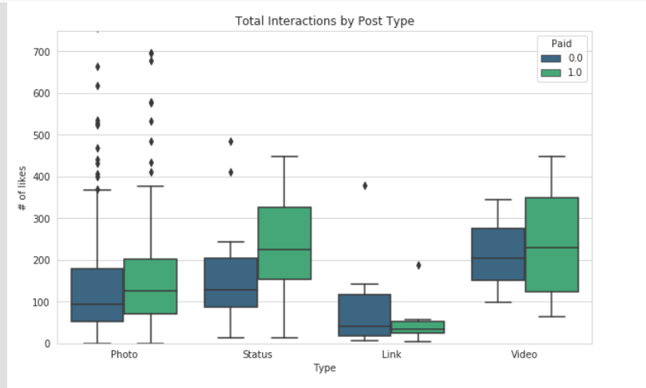
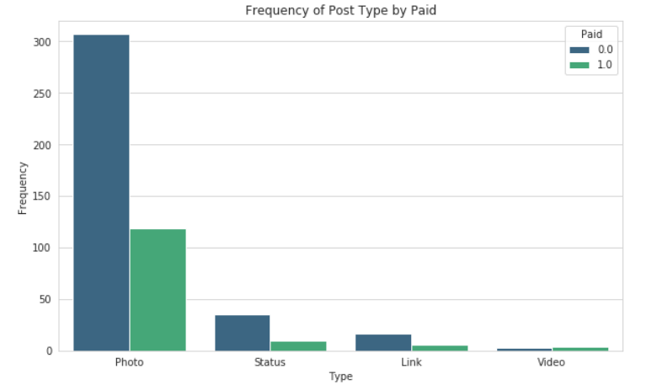
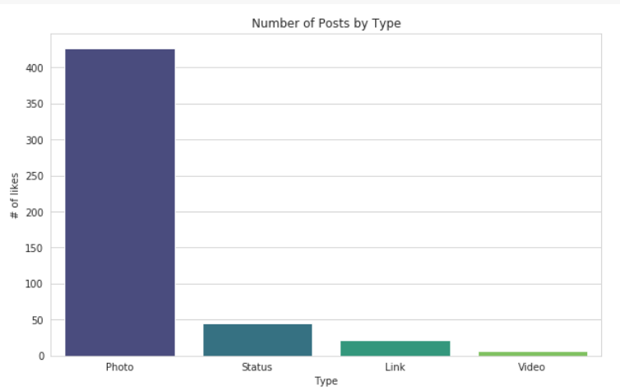
Based on Type Vs Likes
On average video posts had higher engagement
Photo posts had the largest range
This suggests that total interactions can depend on the photo posted

Slide 16
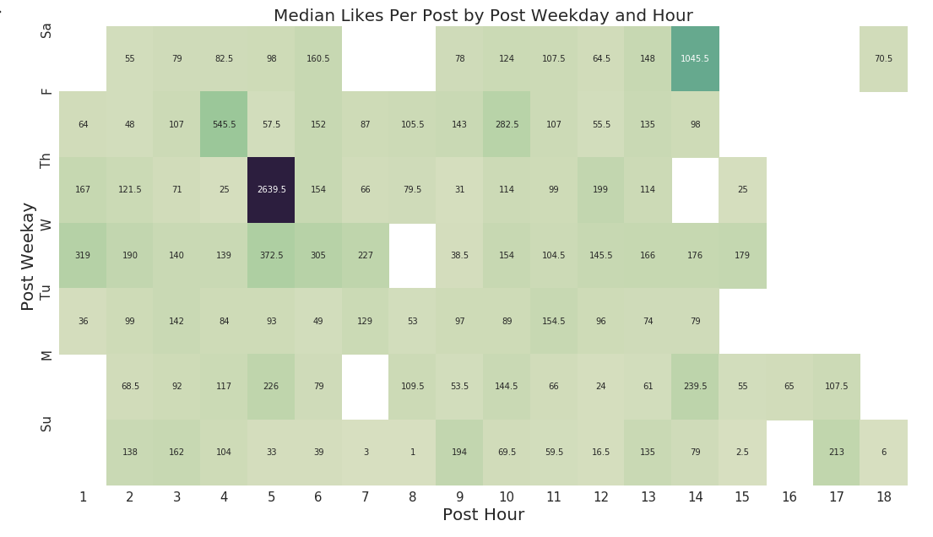

Slide 17
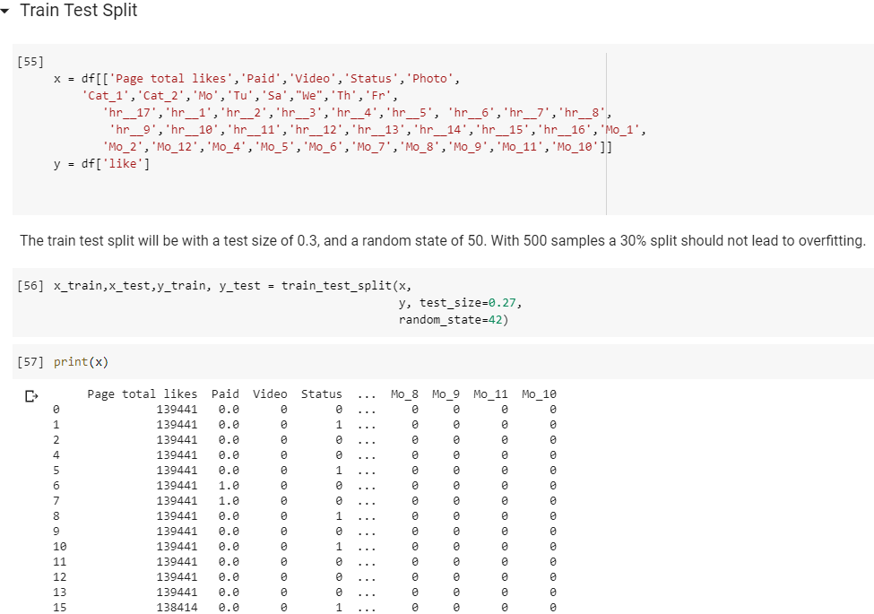
Modelling:
Splitting Train & Test Data

Slide 18
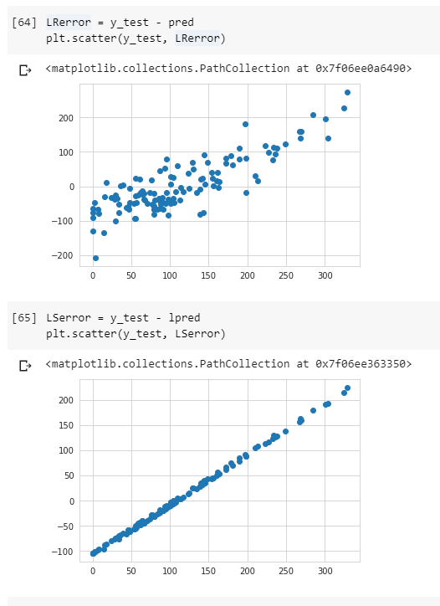
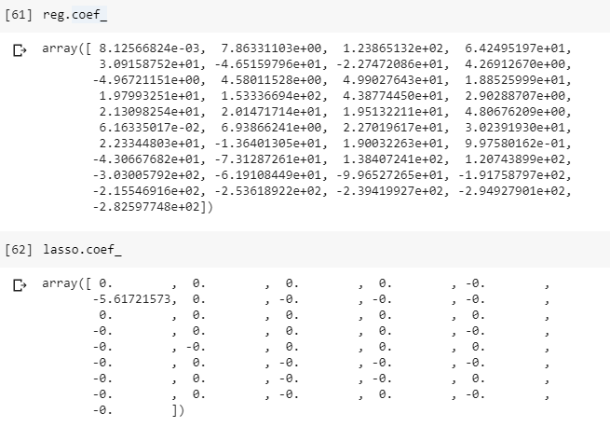
Linear & Lasso Model:
Model Validation:

Slide 19
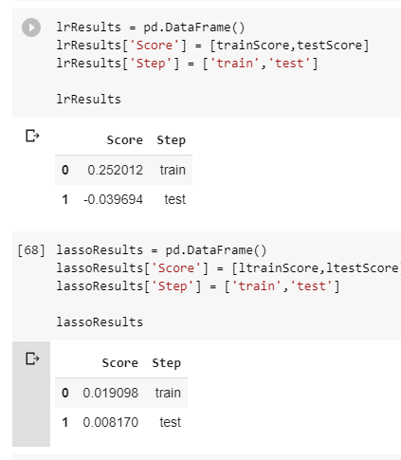
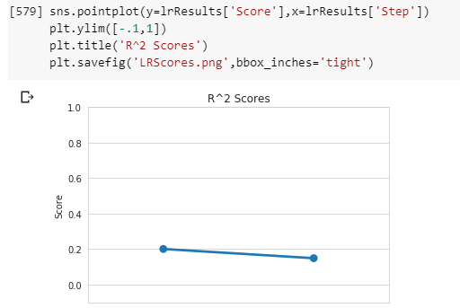
The linear regression model performed poorly overall.
Slight overfitting: the R2 value fell .05 points from train to test
Weak predictive power: .207 R2 train, .154 in test
I had to tune the test set to 10% of the total dataset, to get the highest R2 value in the test set.

Slide 20
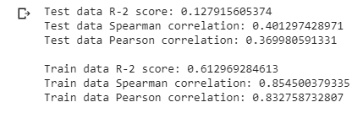
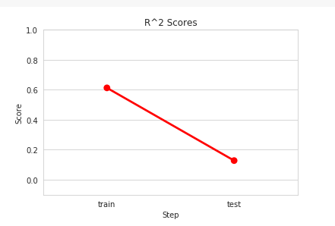
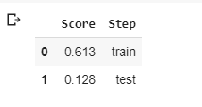
Random Forest Regression Model Validation
Best results came from
RF parameters:
500 estimators
10 min sample split
Train/test split of 0.4
We had solid performance in the train set, with:
.623 R^2 value
- .861 Spearman Correlation
But the model fell apart when using the test set, showing clear signs of overfitting:
.129 R^2 value
- .398 Spearman Correlation

Slide 21
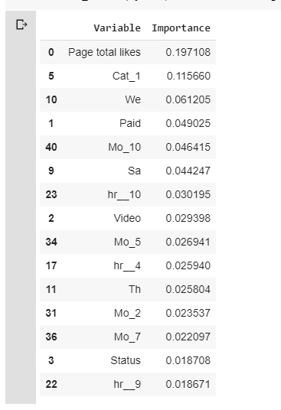
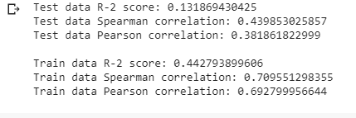
Feature Importance:
Can we improve the model by using only the top 15 features?

Slide 22
Modeling Conclusion:
After iterating through a random forest using the most important variables and seeing no improvement, this suggests that the data here is not rich enough to sufficiently predict likes based only on the information here.
Observations:
Paid posts on average have higher engagement
Paid Status/Photo and Category 1 and 2 posts have the highest improvement so
more paid posts of these types
Video Posts have the highest average engagement, and its not close
more Video posts
Posting Monday in the mid-morning and Wednesday in the early morning
Identify and post during times of high engagement
Place importance on increasing Page Likes
higher probability that a post has “high” engagement Need a richer dataset to predict accurately
identify potentially useful data points and collect them

Slide 23
Thank you!

